Slide 1

Blockchain

Slide 2

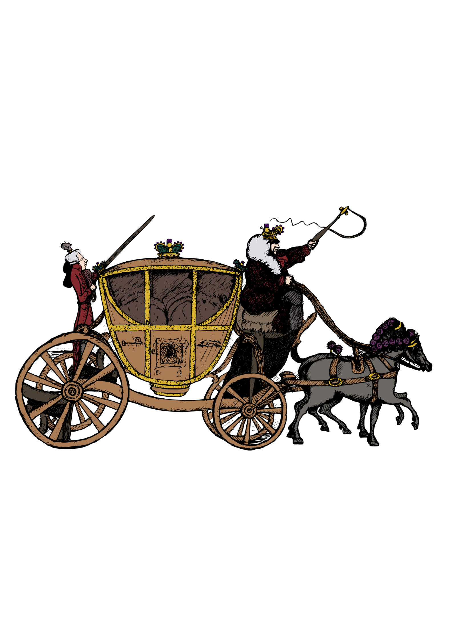

Introduction
Because Blockchain is a disruptive technology.
Q) What is a disruptive technology?

Slide 3
Introduction
Internet Communication
Blockchain Trust

Slide 4
Contents of Blockchain
What is Blockchain?
Distributed P2P Networks
Hashing Algorithm
What is Mining?
Immutable Ledger
Applications of Blockchain

Slide 5
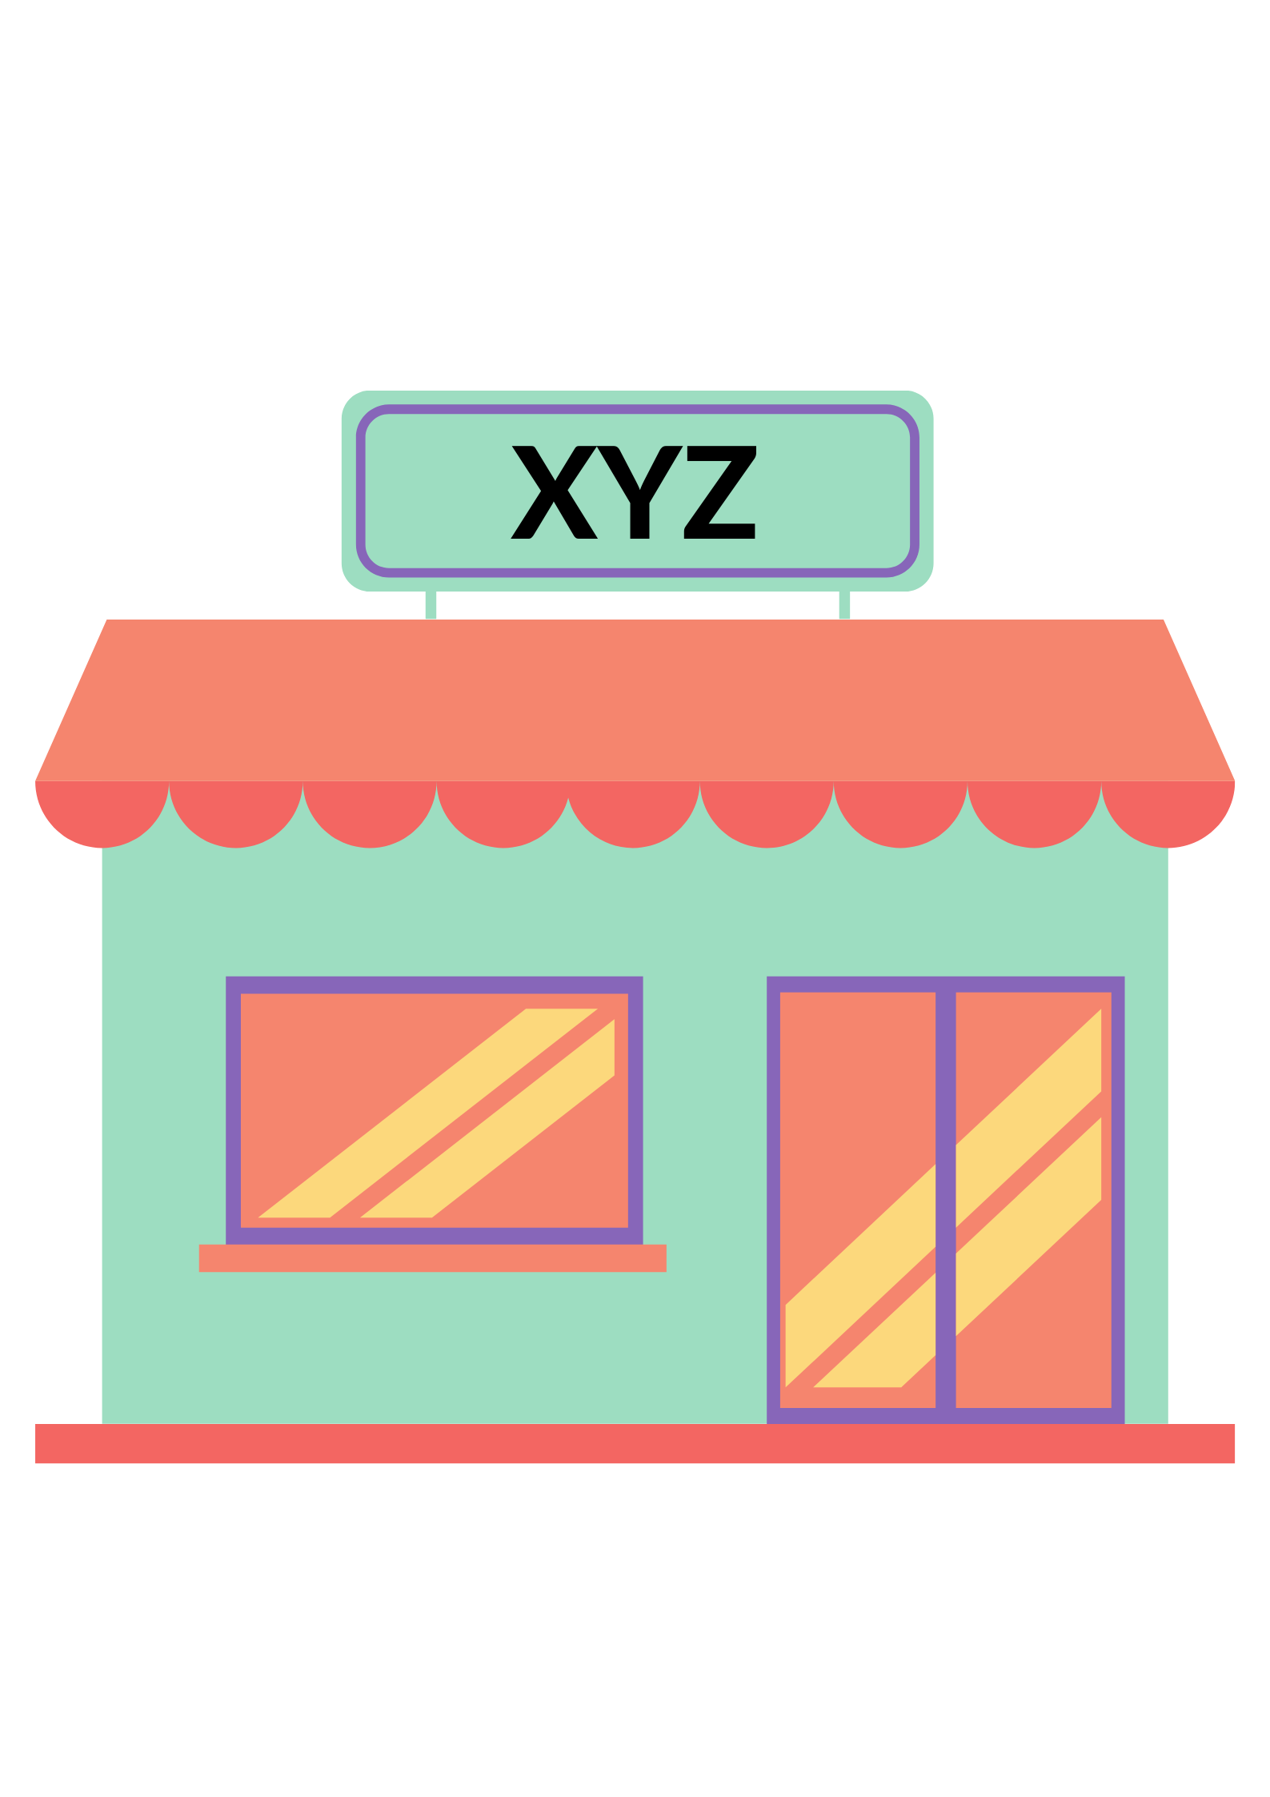

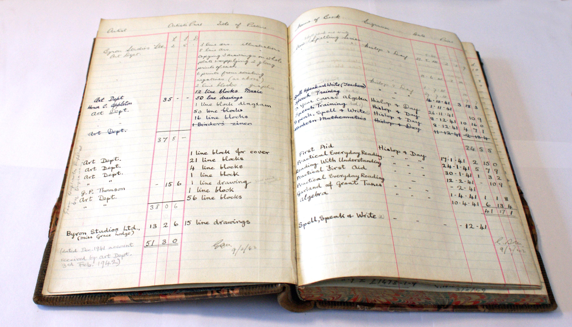

What is Blockchain?
Entry
Ledger Book

Slide 6
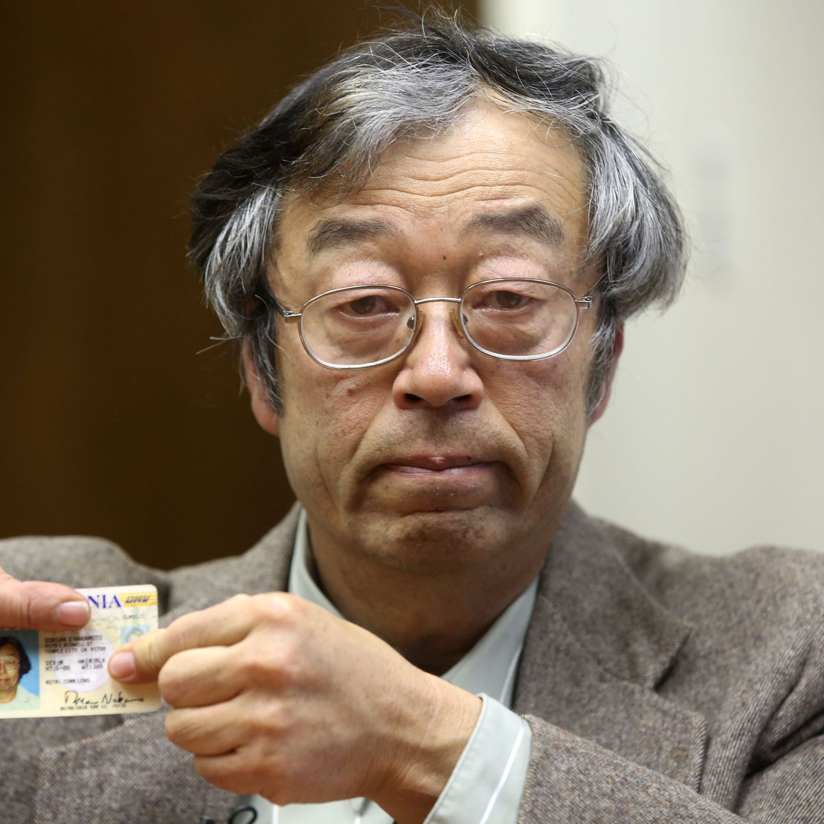
History
SHATOSHI NAKAMOTO

Slide 7
History
The blockchain was popularized by a person (or group of people) using the name Satoshi Nakamoto in 2008 to serve as the public transaction ledger of the cryptocurrency bitcoin, based on work by Stuart Haber, W. Scott Stornetta, and Dave Bayer.
The identity of Satoshi Nakamoto remains unknown to date. The implementation of the blockchain within bitcoin made it the first digital currency to solve the double spending problem without the need of a trusted authority or central server.

Slide 8

What is Blockchain?

Slide 9


What is Blockchain?
Blockchain is a distributed immutable ledger which is completely transparent.

Slide 10
What is Blockchain?
Ledger Book
Block

Slide 11

A
B
E
F
C

Slide 12

Immutable Ledger

Slide 13

Hashing Algorithm

Slide 14
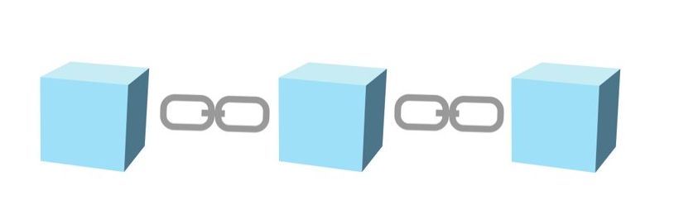
Hashing Algorithm
Block No.-1
Data
Prev Hash:000000000
Hash:0000D8C42
Block

Slide 15

Hashing Algorithm
Block No.-1
Data
Prev Hash:000000000
Hash:0000D8C42
Fingerprint
Block

Slide 16
Hashing Algorithm
Document, Audio , Video etc.
SHA256
5819E961F19967B4ECB2429085E17909CFFD4DCB6267D0067F6CAEC22150A7B1
This has 64 hexadecimal characters.
Each character is of 4 bits.
So in total it has 64* 4 bits i.e. 256 bits.

Slide 17
Hashing Algorithm
Block No.-
Data
SHA 256
Prev Hash:
Hash:

Slide 18
Hashing Algorithm
Block No.-1
Data
Prev Hash:000000000
Hash:0000D8C42
Block

Slide 19
Hashing Algorithm
Block No.-1
Block No.-2
Data
Data
Prev Hash:000000000
Prev Hash:
Hash:0000D8C42
Hash:00003A459

Slide 20
Hashing Algorithm
Block No.-1
Block No.-2
Block No.-3
Data
Data
Data
Prev Hash:000000000
Prev Hash:0000D8C42
Prev Hash:00003A459
Hash:0000D8C42
Hash:00003A459
Hash:00003D45F
Genesis Block

Slide 21
Hashing Algorithm
The five requirements of Hash Algorithm-
One Way
Encrypted
Data
Withstand Collisions
Data
Deterministic
Avalanche Effect
ABC
845
Fast Computation

Slide 22
Immutable Ledger
Immutable ledger in blockchain refers to any records that have the ability to remain unchanged. It cannot be altered and hence the data cannot be changed with ease, thereby making sure that the security is quite tight. Immutability means that it is very difficult to make changes without collusion. The central idea behind the blockchain ledger is the security of data and the proof that data has not been changed or altered. Let us delve a bit deeper into the topic to understand more about blockchain immutability and the benefits it offers

Slide 23


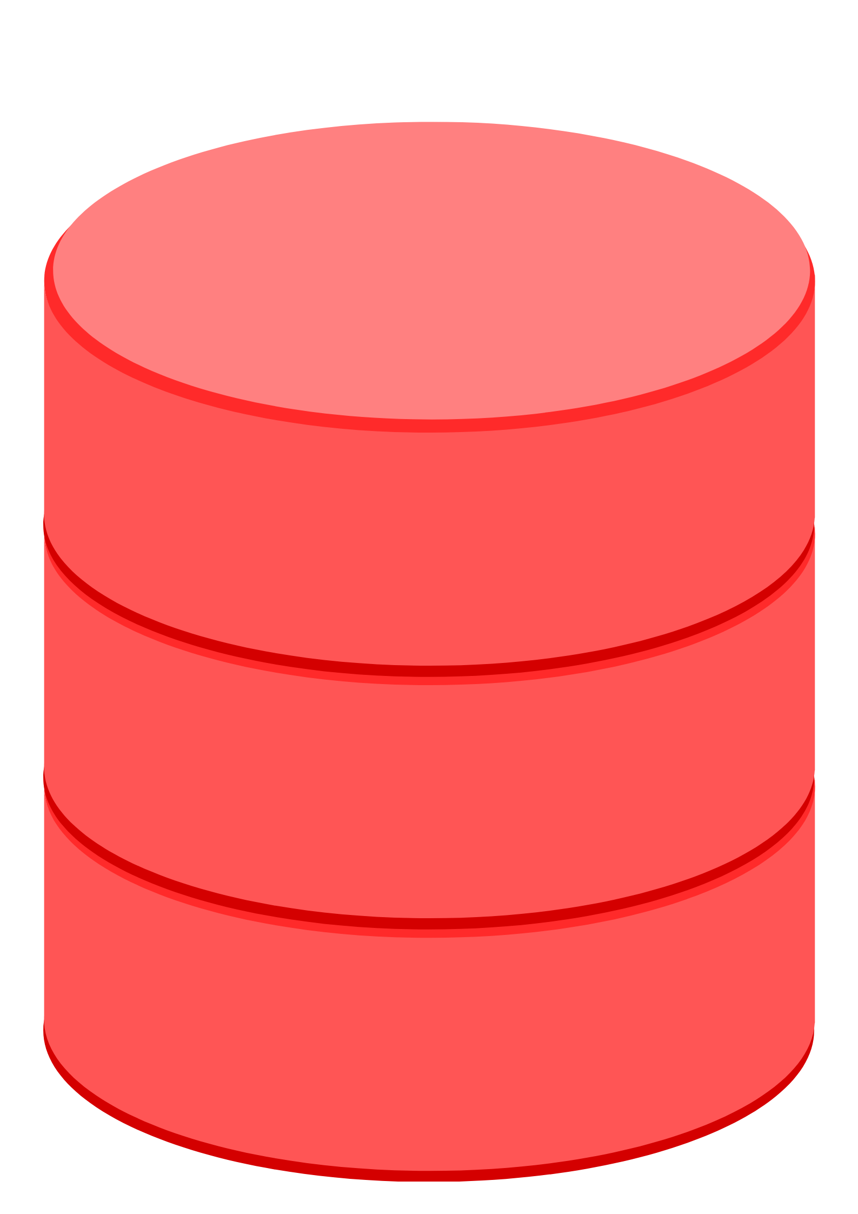
Immutable Ledger
Maintain Register
Institution
Centralized Database

Slide 24
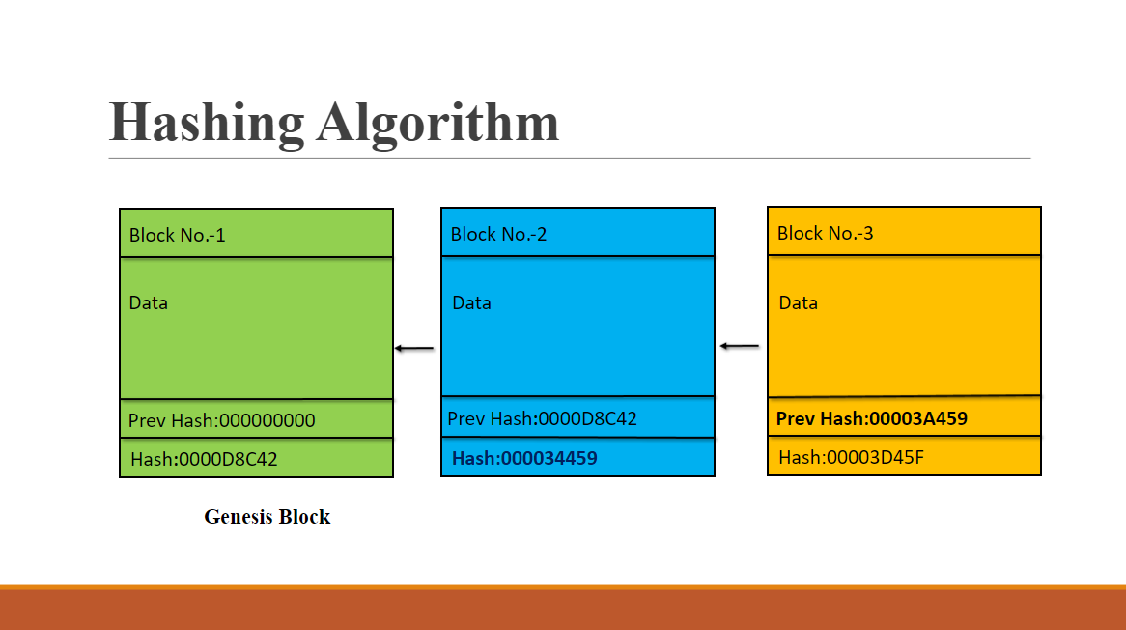


Immutable Ledger
From previous lecture..
Hacker Attacks
Corrupted
A
B
C
D
E
F

Slide 25

Distributed P2P network in Blockchain

Slide 26
Distributed P2P network
A
B
E
F
C

Slide 27
Distributed P2P network
Hacker Attacks
Corrupted
A
B
C
D
E
F
Concept of Immutability

Slide 28

Distributed P2P network
A
B
E
F
C

Slide 29

Applications of Blockchain

Slide 30




Applications of Blockchain
Product Tracking
Healthcare System
Smart Contracts
International Wire Transfer

Slide 31
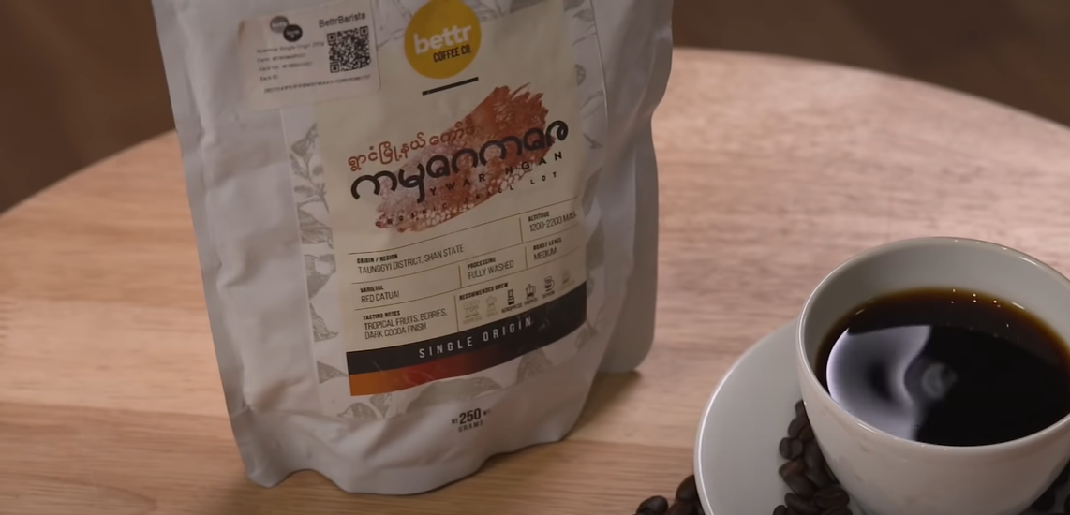
Product Tracking
Coffee

Slide 32
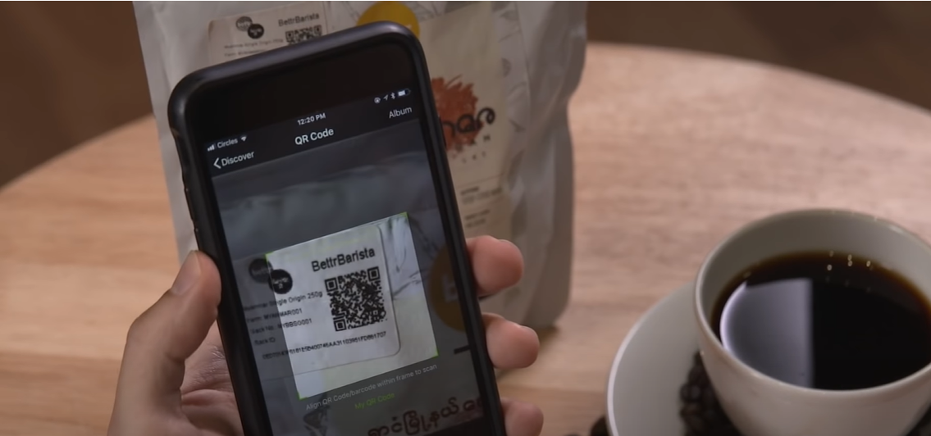
Product Tracking
Scan Barcode

Slide 33

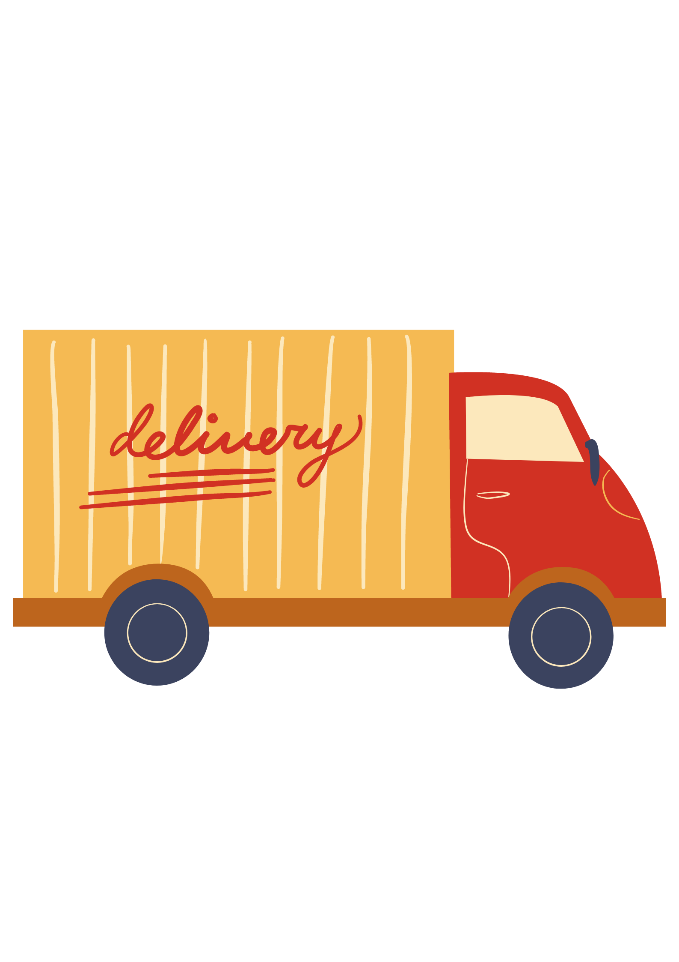
Smart Contract
A
B

Slide 34

Smart Contract
A
B

Slide 35
Smart Contract
Smart Contract
If IOT detected a temperature> 30 degree Celsius
Cancel delivery and do not pay to A.
Yes
No
Note-Assuming optimum temperature <30 degree Celsius.
Do delivery and transfer money to A.

Slide 36


International Wire Transfer
Slow Bank
Sender Bank
Correspondent Bank
Receiver Bank

Slide 37



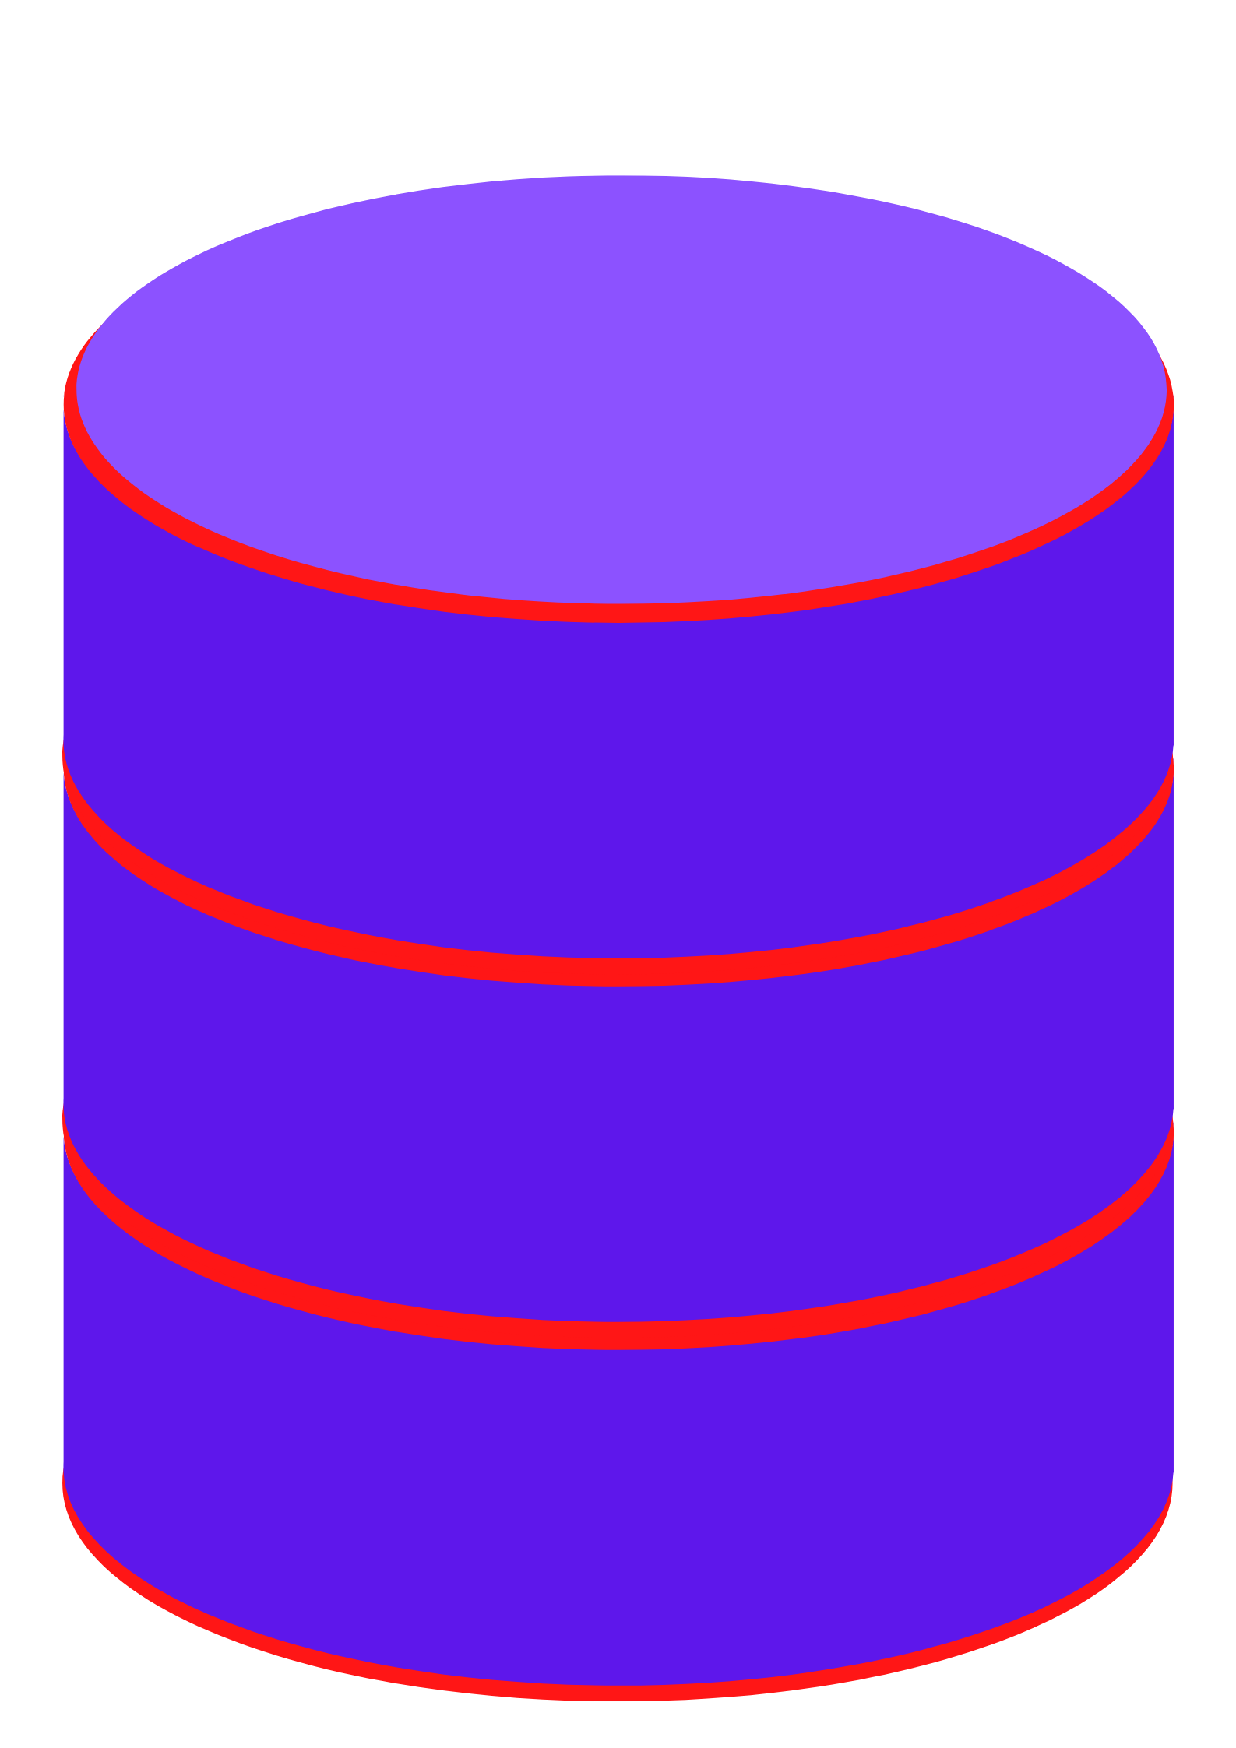
Healthcare System
City A
City B
Medical History

Slide 38
Healthcare System
City A
City B

Slide 39
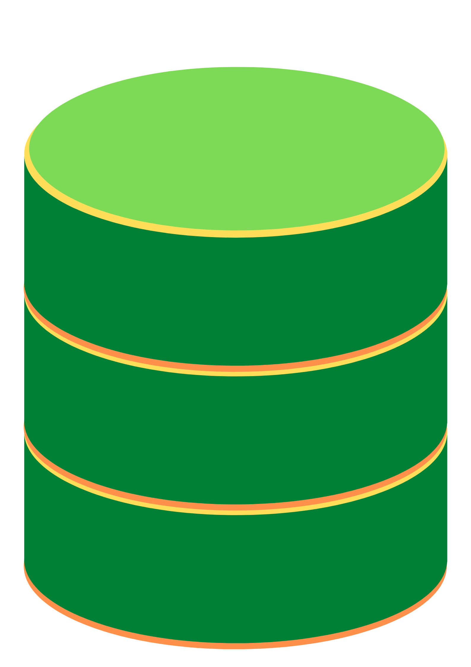
Healthcare System
B
A

